Slide 1
Ordination making sense of complex datasets
Alejandro Ordonez
Assistant Professor - Department of Bioscience
Section for Ecoinformatics & Biodiversity
Center for Biodiversity Dynamics in a Changing World (BIOCHANGE)

Slide 2
Ordination What we will talk about today
What is Ordination
Ordination as a multivariate approach
Correlations based multivariate approaches
Principal Components Analysis (PCA)
Correspondence Analysis (CA)
Distance based multivariate approaches
Principal Coordinates Analysis (PCoA)
(Non) metric dimensional Scaling (N)MDA

Slide 3
Any questions?
Ready to start?

Slide 4
The problem at hand
Organism attributes
Biological/ecological datasets are multidimensional
What is multidimensional? → multiple descriptors are recorded from a number of objects (i.e., replicate sampling or experimental units)
Organisms: morphological or physiological measurements
Ecological sampling units: the variables might be physicochemical measurements or species abundances
Ecological sampling units

Slide 5
multivariate Data description Ordination vs Classification
While CLASSIFICATION looks for discontinuities in a dataset…
ORDINATION extracts the main trends in the form of continuous axes
The aim of ordination methods:
Represent the data along a reduced number of orthogonal axes, representing, in decreasing order, the main trends of variation of the data.

Slide 6
Ordination - What is done?
Ordination is about re-arranging multivariate objects by assigning each object new coordinates such that similar points are near each other based on their descriptors.
Methods include:
PCA
PCoA
CA
(D)CO
(N)MDS
Euclidean variable reduction
Think a data set whose variables are normally distributed
Rank order variable reduction
Think a data set whose variables are NOT normally distributed

Slide 7
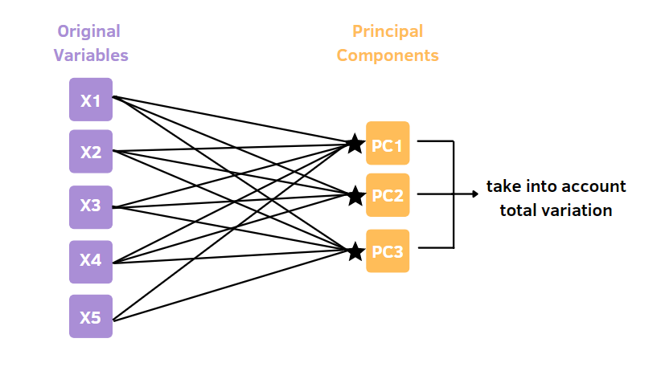
Ordination Why go to all the trouble?
Variable reduction:
Reduce the number of dimensions to a more manageable number while…
Minimising (in some way) distortion in the data.
Maximising (in some way) the resulting information.

Slide 8
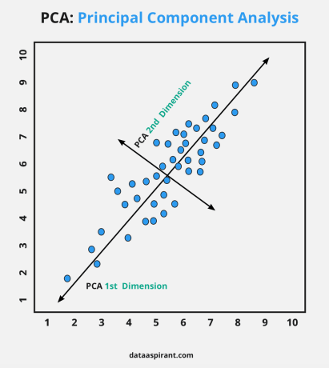
Ordination Why go to all the trouble?
Solve problems of collinearity of the data:
New axes along which descriptors/objects are arranged are independent of each other…
can be used as predictors in a regression.
PC-1 and PC-2 are independent from each other

Slide 9
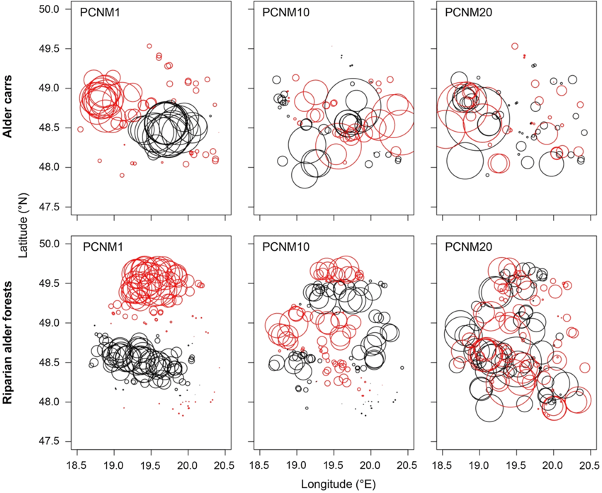
Ordination Why go to all the trouble?
Solve Autocorrelation problems:
You can develop a series of axes of variation that describe the “similarity” between observations → can be used as predictors in a regression.

Slide 10
So far so good?
Any questions?
Ready to move on?

Slide 11
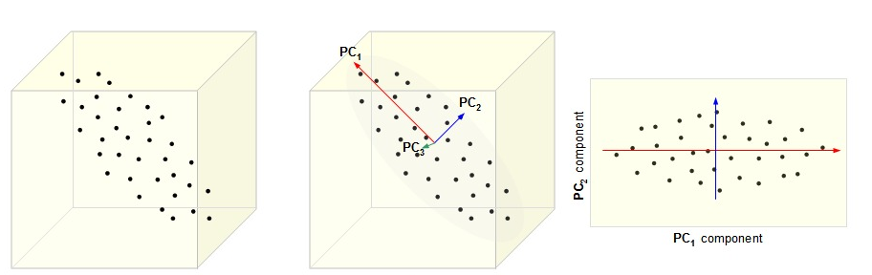
Ordination: How does look like Graphically?
Original data
Dimension reduction
Ordination
http://cnx.org/content/m11461/latest/

Slide 12
ordination: How does look like Numerically?
Original coordinates
Ordinated coordinates
 | Var 1 | Var 2 | Var 3 | Var 4 | Var 5
Obs 1 | 0.471 | 1.07 | -1.60 | 1.145 | -0.724
Obs 2 | 1.37 | 0.900 | 1.03 | -0.696 | 0.793
Obs 3 | -1.27 | -0.764 | 0.939 | -1.03 | -1.49
Obs 4 | 0.527 | 0.967 | 0.778 | 1.05 | 0.821
Obs 5 | -0.911 | -0.618 | 0.053 | -0.936 | -1.13
Obs 6 | 0.030 | -0.098 | 0.562 | -0.702 | 0.759
Obs 7 | 0.914 | 0.286 | -0.904 | 1.27 | -0.059
Obs 8 | -1.14 | -1.74 | -0.855 | -0.102 | 1.03
 | PCA 1 | PCA 2 | PCA 3 | PCA 4 | PCA 5
Obs 1 | -1.540 | 1.621 | -0.789 | 0.259 | -0.320
Obs 2 | -0.968 | -1.902 | -0.079 | 0.570 | 0.080
Obs 3 | 2.246 | -0.187 | -1.078 | -0.365 | 0.112
Obs 4 | -1.453 | -0.770 | 0.184 | -0.919 | -0.129
Obs 5 | 1.656 | 0.303 | -0.711 | 0.207 | -0.039
Obs 6 | 0.295 | -0.971 | 0.544 | 0.213 | -0.164
Obs 7 | -1.488 | 0.965 | 0.000 | 0.005 | 0.481
Obs 8 | 1.252 | 0.940 | 1.928 | 0.030 | -0.021
How can we do this transformation?

Slide 13
Ordination Basics: Euclidean Variable Transformation
The goal of a Euclidean Variable Transformation is
deriving a linear combinations of the variables that
summarise the variation in the original data set.
What does this mean?:
We are “consolidating” the variance from a data matrix into a new set of variables.
The new variables are a linear combination of the original variables.
The new variables are independent/uncorrelated. → orthogonal.

Slide 14
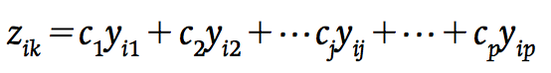
Ordination Basics : Euclidean Variable Transformation
Total variance
Original variables
New variable
Derived variable 1
Derived variable 2
Proportion of the variance explained
…
Derived variable k
Depending on the analysis z_{ik} can be called: discriminant functions, canonical functions or variates, principal components or factors.

Slide 15
Ordination Basics: Eigenvectors and Eigenvalues
Eigenvalues (λ):
The amount of the original variance explained by each of the new derived variables.
Eigenvalues are population parameters.
They change based on the sample → a new or a larger sample changes these!
Eigenvector:
Lists of the coefficients or weights showing how much each original variable contributes to each new derived variable (c₁ to c_{p}).
The c_{p} coefficients can be rescaled in different ways and are often represented as u_{j}, v_{j}, or w_{j.}

Slide 16
Ordination Basics: Euclidean Variable Transformation
Eigenvalues
Eigenvector Axis 1
λ₁
Derived variable 1
Eigenvector Axis 2
Proportion of the variance explained
λ₂
Derived variable 2
…
Eigenvector Axis k
Derived variable k
λ_{k}
Total variance

Slide 17
So far so good?
Any questions?
Ready to move on?

Slide 18
Principal Components Analysis PCA
One of the most commonly used multivariate statistical techniques, and it is also the basis for some others.
PCA transforms the original variables into a new set of uncorrelated variables.
Principal components or factors.
Object new positions along each component are called z-scores.

Slide 19
Which are the PCA assumptions?
PCA is a linear geometric transformation that preserves EUCLIDEAN distances.
Creates a series of orthogonal axes based on linear associations.
The new positions can be plotted in a traditional cartesian system.
It is applicable to any multivariate set of continuous variables that are multivariate normal.

Slide 20
Which are the PCA assumptions?
PCA are
Useful for complex environmental data associated to this information.
Not useful for ecological community data (abundances)
Why? These are often non-normal → But see Borcard et al (2011) Numerical Ecology for a way you can use it with species data.

Slide 21
Principal Components Analysis (PCA)
What is a PCA doing?:
PCA can be viewed as a rotation of the principal axes of variation after centring to the mean

Slide 22
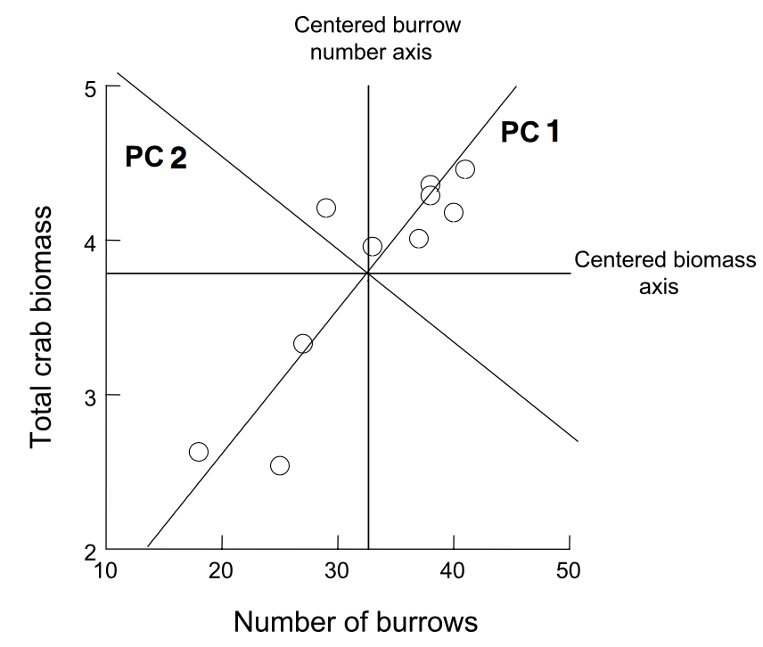
Principal Components Analysis (PCA)
What do I need to make this rotation?
The eigenvectors matrix is used as a rotational matrix
How does this rotation take place?
Matrix multiplication of the original data and a eigenvectors matrix for the objects
PC1
PC2

Slide 23
Principal Components Analysis (PCA)
A PCA by hand
# The A data frame is a random example
A = matrix(runif(40),ncol = 5)
# We centre the original data
A = scale(A)
pca = eigen(cov(A))
pca
eigen() decomposition
$values
[1] 2.85711173 1.25955149 0.47876091 0.35415461 0.05042126
$vectors
[,1] [,2] [,3] [,4] [,5]
[1,] -0.4569472 0.28275491 0.64234686 -0.54474600 -0.04348833
[2,] -0.4243838 0.52377391 -0.50877502 0.07029859 -0.53081577
[3,] -0.2979562 -0.76011387 0.06070147 -0.02724050 -0.57360462
[4,] 0.5117588 0.26016024 0.48519784 0.32376386 -0.57461254
[5,] -0.5103162 0.01594062 0.29906000 0.76989923 0.23904298
Note I use the Covariance matrix
Eigenvalues (λ)
Eigenvectors

Slide 24
Principal Components Analysis (PCA)
A matrix multiplication of predictors and eigenvectors
A PCA by hand
# Estimate the PCA positions of each observation
pA = A %*% pca$vectors
pA
[,1] [,2] [,3] [,4] [,5]
[1,] 0.2519 0.3819 -1.6000 -0.0869 0.1131
[2,] 2.8341 0.0157 0.0525 -0.0420 -0.2557
[3,] -1.7016 -0.6275 0.1870 0.1672 -0.3464
[4,] 1.7111 0.2273 0.4506 -0.5922 0.0196
[5,] 0.1843 1.2451 0.7008 0.5105 0.2946
[6,] -1.8173 -0.4385 0.2348 -1.0828 0.1304
[7,] 0.1839 -2.1569 0.0312 0.6726 0.1797
[8,] -1.6463 1.3529 -0.0569 0.4536 -0.1353

Slide 25
Principal Components Analysis (PCA)
An automatic version of PCA in R is implemented in two methods in the stats package (which is a default package in R)
princomp() → Spectral Decomposition Approach.
prcomp() → Singular Value Decomposition Approach.
The method is part of other packages
rda() form the vengan package.
pca() from the ada package.
These are the preferred approaches!!
Why?
You don’t need to think if you should use a correlation or a covariance matrix as input

Slide 26
Principal Components Analysis (PCA)
An automatic version of PCA in R is implemented in two methods in the stats package (which is a default package in R)
prcomp() → Singular Value Decomposition Approach
princomp() → Spectral Decomposition Approach
Automatic PCA in R
A = matrix(runif(80),ncol = 5)
pca.1 = prcomp(A, scale=TRUE) # The center and scale argument do the same thing as scaling before the analysis
pca.2 = princomp(A, cor=TRUE) # cor argument sets if a correlation or covariance matrix is used for the calculations

Slide 27
Principal Components Analysis (PCA)
Singular Value Decomposition Approach
pca.1 = prcomp(A, scale=TRUE)
pca.1
Standard deviations (1, .., p=5):
[1] 1.3190 1.0990 0.9685 0.7995 0.6891
Rotation (n x k) = (5 x 5):
PC1 PC2 PC3 PC4 PC5
[1,] 0.45446661 -0.49025627 0.064489563 -0.7221743 0.16557261
[2,] 0.01498967 0.67381229 0.611531781 -0.3385741 0.23905810
[3,] 0.62254486 0.18372183 0.132351368 0.1089443 -0.74114671
[4,] 0.61737109 0.02718466 0.001421953 0.5077964 0.60021223
[5,] -0.15660859 -0.52070440 0.777400199 0.3067668 -0.07670569
Spectral Decomposition Approach
pca.2 = princomp(A, cor=TRUE)
summary(pca.2)
Importance of components:
Comp.1 Comp.2 Comp.3 Comp.4 Comp.5
Standard deviation 1.3190448 1.0990282 0.9685031 0.7995557 0.68918095
Proportion of Variance 0.3479758 0.2415726 0.1875996 0.1278579 0.09499408
Cumulative Proportion 0.3479758 0.5895484 0.7771481 0.9050059 1.00000000

Slide 28
Principal Components Analysis: Eigenvectors and Eigenvalues
Spectral decomposition (SDC)
Transform an association matrix of variables based on a linear combination of Eigenvectors.
L = U’ C U
C: Correlation/Covariance matrix (p x p).
U: Matrix of eigenvectors of objects (n x p).
Define the transformation coefficients of each original variable to generate the new variable.
This is a constraint matrix.
L: Eigenvalue matrix (n x p).

Slide 29
Principal Components Analysis: Eigenvectors and Eigenvalues
Singular value decomposition (SVD)
Transform an association matrix of variables using both the associations between objects and an Eigenvector matrix
Y = Z L^{1/2} U’
Y: A matrix of centred data (n x p)
L: Eigenvalue matrix (n x p)
Z: Matrix of eigenvectors for variables (n x p)
U: Matrix of eigenvectors of objects (p x p)
Type of data used defines the equivalence between methods:
raw data ➔ SDC of the Squ & Cross Prod matrix (SSCP)
centred data ➔ SDC of the covariance matrix
centred and standardized ➔ SDC of the correlation matrix

Slide 30
correlation or covariance? Implementing princomp()
The usual rule
covariance matrix when the variable scales are similar → SAME UNITS
correlation matrix when variables are on different scales → DIFFERENT UNITS
However, using a correlation matrix for different scales is only ok if the variability of the variables is similar

Slide 31
correlation or covariance? Implementing princomp()
Alternative rules
Use the covariance matrix when variance of the original variable is important
This preserves variance if the range and scale of variables is similar or in the same units of measure
Use the correlation matrix when variance of the original variable is NOT important
This is within-variable range and scale widely differs

Slide 32
So far so good?
Any questions?
Ready to move on?

Slide 33
Extracting information of a PCA
> A = matrix(runif(80),ncol = 5) # Generate a random data set.
> pca.1 = prcomp(A, scale=TRUE) # Determine the Principal Components.
> pca.1
Standard deviations (1, .., p=5):
[1] 1.2952528 1.1212786 0.9895085 0.7936766 0.6752814
Rotation (n x k) = (5 x 5):
PC1 PC2 PC3 PC4 PC5
[1,] 0.4660372 -0.3331315 0.52570083 -0.5096097 -0.3684689
[2,] 0.5079742 0.1690350 -0.62387417 0.1138295 -0.5578649
[3,] -0.3726916 0.6051757 -0.07786541 -0.6683264 -0.2052806
[4,] 0.6020957 0.3326498 -0.07300934 -0.2356989 0.6825984
[5,] 0.1528179 0.6193198 0.56835400 0.4744751 -0.2119829
> A = matrix(runif(80),ncol = 5) # Generate a random data set.
> pca.1 = prcomp(A, scale=TRUE) # Determine the Principal Components.
> pca.1
Standard deviations (1, .., p=5):
[1] 1.2952528 1.1212786 0.9895085 0.7936766 0.6752814
Rotation (n x k) = (5 x 5):
PC1 PC2 PC3 PC4 PC5
[1,] 0.4660372 -0.3331315 0.52570083 -0.5096097 -0.3684689
[2,] 0.5079742 0.1690350 -0.62387417 0.1138295 -0.5578649
[3,] -0.3726916 0.6051757 -0.07786541 -0.6683264 -0.2052806
[4,] 0.6020957 0.3326498 -0.07300934 -0.2356989 0.6825984
[5,] 0.1528179 0.6193198 0.56835400 0.4744751 -0.2119829
Eigenvectors

Slide 34
Extracting the useful information of a PCA
Y₅=-(0.37*X₁)-(0.56*X₂)-(0.20*X₃)+…
Standard deviations (1, .., p=5):
[1] 1.2952528 1.1212786 0.9895085 0.7936766 0.6752814
Rotation (n x k) = (5 x 5):
PC1 PC2 PC3 PC4 PC5
[1,] 0.4660372 -0.3331315 0.52570083 -0.5096097 -0.3684689
[2,] 0.5079742 0.1690350 -0.62387417 0.1138295 -0.5578649
[3,] -0.3726916 0.6051757 -0.07786541 -0.6683264 -0.2052806
[4,] 0.6020957 0.3326498 -0.07300934 -0.2356989 0.6825984
[5,] 0.1528179 0.6193198 0.56835400 0.4744751 -0.2119829
Y₁=(0.47*X₁)+(0.51*X₂)-(0.37*X₃)+…

Slide 35
Extracting the useful information of a PCA
A = matrix(runif(80),ncol = 5) # Generate a NEW random data set.
pca.1 = prcomp(A, scale=TRUE) # Determine the Principal Components.
pca.1$x
PC1 PC2 PC3 PC4 PC5
[1,] -1.1577468 -0.155679408 0.02843014 0.79537856 -0.59433350
[2,] -1.3862411 0.084352130 -1.44746588 0.89987729 0.06434587
[3,] 1.2835030 -0.109626990 1.63156616 -0.04464804 -1.04763792
[4,] 0.2852092 -1.189488968 0.43008110 1.56039662 1.28183884
[5,] 0.8246618 -0.967654874 0.07214084 0.38968351 -0.87802227
...
Position of each observation within the Principal Component Space

Slide 36
Extracting the useful information of a PCA
A = matrix(runif(80),ncol = 5) # Generate a NEW random data set.
pca.1 = prcomp(A, scale=TRUE) # Determine the Principal Components.
summary(pca.1) # Summary of the Principal Components Analysis.
Importance of components:
PC1 PC2 PC3 PC4 PC5
Standard deviation 1.319 1.0990 0.9685 0.7996 0.68918
Proportion of Variance 0.348 0.2416 0.1876 0.1279 0.09499
Cumulative Proportion 0.348 0.5896 0.7772 0.9050 1.00000
Spread within each PC-axis
Standard deviation in each direction

Slide 37
Extracting the useful information of a PCA
A = matrix(runif(80),ncol = 5) # Generate a NEW random data set.
pca.1 = prcomp(A, scale=TRUE) # Determine the Principal Components.
summary(pca.1) # Summary of the Principal Components Analysis.
Importance of components:
PC1 PC2 PC3 PC4 PC5
Standard deviation 1.319 1.0990 0.9685 0.7996 0.68918
Proportion of Variance 0.348 0.2416 0.1876 0.1279 0.09499
Cumulative Proportion 0.348 0.5896 0.7772 0.9050 1.00000
Explained variance
Eigenvalues (λ_{i})

Slide 38
So far so good?
Any questions?
Ready to move on?

Slide 39
How many PC’s?
No clear-cut rules, only rules of thumb
Possibility - 1: Cumulative proportion should be at least 0.7 or 0.8 (i.e. 70/80% of variance is captured)
Possibility - 2: Look at scree-plot and keep:
PC’s before the “elbow” (if there is any...)
PC’s axes whose eigenvalues are larger than the length of the corresponding piece form a theoretical broken stick

Slide 40
How many PC’s? Cumulative Proportion
With a 70-to-80% variance explain cut-off means only PC-1 and PC-2 need to be kept!
> data(USArrests)
> pca.2 <- prcomp(USArrests, scale = TRUE)
> summary(prcomp(USArrests, scale = TRUE))
Importance of components:
PC1 PC2 PC3 PC4
Standard deviation 1.5749 0.9949 0.59713 0.41645
Proportion of Variance 0.6201 0.2474 0.08914 0.04336
Cumulative Proportion 0.6201 0.8675 0.95664 1.00000

Slide 41
Visualising an PCA screeplot
Broken stick approach
Only PC-1 should be kept
Observed var is larger than expected
Elbow approach
PC-1 and PC-2 should be kept

Slide 42
Visualising an PCA – using biplot()
biplot(pca.2,
choices = c(1,2),scale=1)
biplot(pca.2,
choices = c(2,3),scale=1)
How to read a PCA biplot
The names in black represent each location
The red vectors represent the direction and importance of each evaluated variable in the context of the plotted PC-axis.
The angles between red vectors reflect their correlations.
These position are defined by the eigenvectors each PC-axis

Slide 43
So far so good?
Any questions?
Ready to move on?

Slide 44
Correspondence Analysis (CA)
What it is?
An ordination technique the focuses on categorical rather than continuous data → this makes it useful for Species data
Appropriate with unimodal (non-linear) response curves. → This is a requirement for PCA
The goal?
Exploring the relationship between variables in a contingency table.
Define a series of orthogonal axes and, for each item in a table, a set of scores.
The position along these axes preserves the χ2 distance among sites Vs Euclidean distances in a PCA.

Slide 45
Correspondence Analysis (CA)
Practical Points:
All the used categorical data should be in the same scale.
CA must be computed on raw data → DO NOT TRANSFORM!
CA produces one less axis than variables.
Orthogonal axes are ranked in decreasing order.
The focus could be
The sites (usually rows) → this is called scaling =1
The variables (usually columns) → this is called scaling =2
Just like a PCA, The broken stick model can be used as guidance to the number of axes to retain.

Slide 46
Correspondence Analysis (CA) implementing it in R
An automatic version of CA in R is implemented in as part of many packages:
ca() → from the ca package
CA() → from the FactoMineR package
cca() → from the vegan package
This is my preferred option

Slide 47
Correspondence Analysis (CA) implementing it in R
> require(vegan)
> data(varespec)
> CA.ord = cca(varespec)
> CA.ord
Call: cca(X = varespec)
Inertia Rank
Total 2.083
Unconstrained 2.083 23
Inertia is scaled Chi-square
Eigenvalues for unconstrained axes:
CA1 CA2 CA3 CA4 CA5 CA6 CA7 CA8
0.5249 0.3568 0.2344 0.1955 0.1776 0.1216 0.1155 0.0889
(Showing 8 of 23 unconstrained eigenvalues)
The proportion explained is estimated by divining each Eigenvalue by the
Total inertia
Unlike in a PCA these are NOT the amount of variation represented along an axis

Slide 48
Correspondence Analysis (CA) How many axes?
Amount of variation represented along an axis
data(varespec)
CA.ord = cca(varespec)
# Extract the total inertia
Total.Inertia <- CA.ord $CA$tot.chi
# Extract the Eigenvalues for each axis
EigenVal <- CA.ord$CA$eig
# Estimate the Amount of variation represented along an axis
round(EigenVal/Total.Inertia,4)
CA1 CA2 CA3 CA4 CA5 CA6 CA7 CA8 CA9 CA10
0.2520 0.1713 0.1125 0.0938 0.0853 0.0584 0.0554 0.0427 0.0351 0.0276
CA11 CA12 CA13 CA14 CA15 CA16 CA17 CA18 CA19 CA20
0.0213 0.0122 0.0082 0.0072 0.0049 0.0038 0.0029 0.0019 0.0014 0.0009
CA21 CA22 CA23
0.0009 0.0003 0.0001
Like in a PCA the first axis captures most of the variance

Slide 49
Correspondence Analysis (CA) How many axes?
Amount of variation represented along an axis
data(varespec);CA.ord = cca(varespec)
# Extract the Amount of variation represented along an axis
summary(CA.ord)$ cont$ importance
Importance of components:
CA1 CA2 CA3 CA4 CA5 CA6 CA7 CA8 CA9
Eigenvalue 0.525 0.357 0.234 0.195 0.178 0.122 0.115 0.089 0.073
Proportion Explained 0.252 0.171 0.113 0.094 0.085 0.058 0.055 0.043 0.035
Cumulative Proportion 0.252 0.423 0.536 0.630 0.715 0.773 0.829 0.871 0.906
..
Like in a PCA the first axis captures most of the variance
You can also use the cumulative proportion to select the number of axes

Slide 50
Correspondence Analysis (CA) How many axes?
Broken stick approach
Observed var is larger than expected
The first 5 axes should be kept
data(varespec)
CA.ord = cca(varespec)
screeplot(CA.ord,
bstick = TRUE,
npcs = length(CA.ord $CA$eig),
main="CA Vegetation in lichen pastures",
cex.lab=2,cex.axis=1.5,cex.main=2)

Slide 51
Correspondence Analysis (CA) Visualising an ca
Scaling 1 and 2 produce different plots
Scaling 2 Appropriate to look the ordination of Species
Scaling 1
Appropriate to look the ordination of Sites
Species are centroids of Sites
Sites are centroids of species
Species
Sites

Slide 52
Correspondence Analysis (CA) Visualising an ca
In scaling 1 biplots, the sites are at chi-square distances of one another (blue arrows)
The contributions of the species to the sites are reflected by the site-to-species distances (red arrows).
The species are around the sites, in positions reflecting their abundances at each site.
Scaling 1
Appropriate to look the ordination of Sites
Sites are centroids of species

Slide 53
Correspondence Analysis (CA) Visualising an ca
In scaling 2 biplots, the species are at chi-square distances of one another (Blue arrow).
The sites are around the species, in positions reflecting species abundances at the sites (red arrows).
Species proximity to a site means it is more abundant there.
Scaling 2 Appropriate to look the ordination of Species
Species are centroids of Sites

Slide 54
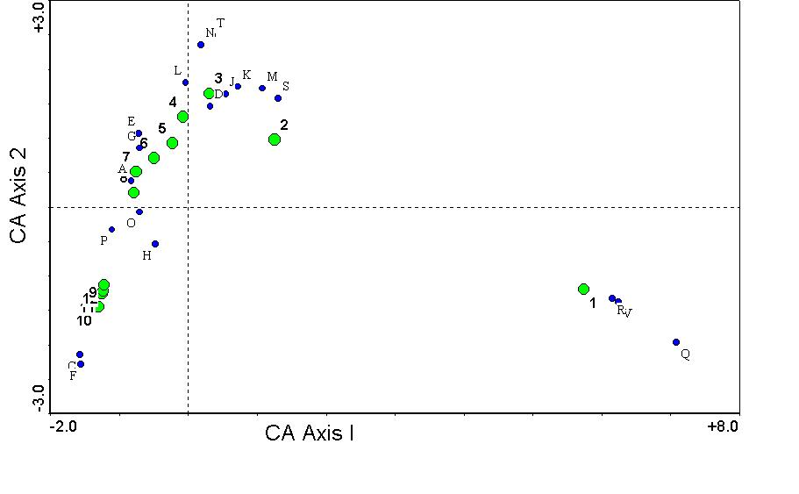
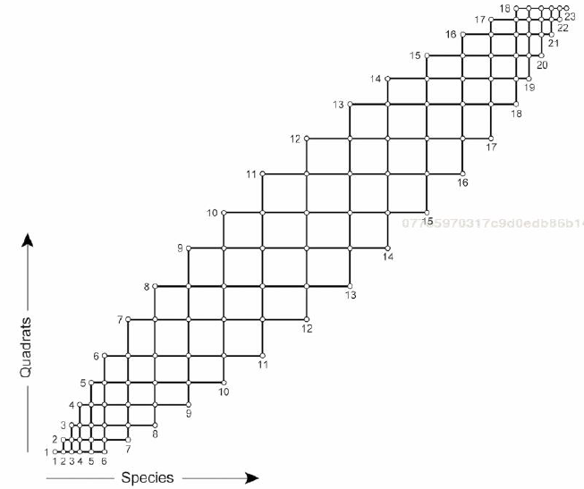
Correspondence Analysis Problems
The “arch effect”
The first two CA axes are not independent – axis 2 is a quadratic function of axis 1
Compression effect
Species and plots at ends of the gradient are ordinated more closely than those in the middle
This is a problem when looking into Long environmental gradients often support a succession of species
Compare these two?

Slide 55
Correspondence Analysis The arch effect Problem
If we simulate a long environmental gradient we can see a succession of spp
The CA will show the shape of an arch as the the chi-square has an upper limit
Chi-square distances between Site 1 and selected sites reaches a maximum after 13 steps

Slide 56
So far so good?
Any questions?
Ready to move on?

Slide 57
The arch effect Problem an ISSUE for PCA and CA
If we simulate a long environmental gradient we can see a succession of spp
The PCA will show a horseshoe shape
[small number of spp vs large number of sites]

Slide 58
Solving the arch effect detrended Correspondence analysis
Detrending is a post-treatment of CA results to stretch the arch and make it linear.
Step-1: axis 1 is divided into an arbitrary number of segments.
Step-2: The mean of the group of sites in each segment is moved to the y=0 so that the mean becomes 0 on axis 2.

Slide 59
Solving the arch effect detrended Correspondence analysis
CA.ord = cca(Y)
DCA.ord <- decorana(Y)

Slide 60
So far so good?
Any questions?
Ready to move on?

Slide 61
dissimilarity based approach Principle Coordinates Analyses
The objective of Principal coordinate analysis (PCoA) is
to represent the evaluated objects in a full-dimensional Euclidean space.
by fully reconstruct the original dissimilarities among the objects in a reduced and orthogonal space.
Think of it as a transformation after the computation of an appropriately chosen dissimilarity measure.
Like PCA and CA, PCoA produces a set of orthogonal axes whose importance is measured by eigenvalues.
This is sometimes called classical multidimensional scaling.

Slide 62
PCA, CA, and PCoA What is the difference?
A PCoA differs from a PCA in that a PCA goal is to preserve the correlation/covariation of objects.
A PCoA differs from a CA in that a CA goal is preserving the Chi-Squared distance among the objects while.
PCoA goal is preserving the ANY TYPE OF DISTANCE among the objects.

Slide 63
Principle Coordinates Analyses An important point
The possibility of using non-metric distances (i.e., Bray Curtis, Gower’s) means that there is a possibility of getting “negative” eigenvalues if the distance matrix is not EUCLIDEAN!
This is bad because it could be so that these negative eigenvalues “overwrite” the variance captured by the first axes.

Slide 64
Principle Coordinates Analyses An important point
You can solve the “negative” eigenvalues problem by adding
Use the squared root of the distance.
Adding a constant to the squared distances ➔ Lingoes correction.
Adding a constant to the raw distances ➔ Cailliez correction

Slide 65
Principle Coordinates Analyses Is my distance Euclidean
C
B
A reminder:
Euclidean property means that the distance follows the Pythagoras formula.
> require(vegan)
> require(ade4)
> data(mite)
> mat1 = as.matrix(mite[1:10, 1:15])
> #Example 1: compute Bray Curtis distance for mat1
> spe.bray <- vegdist(mat1)
> ade4::is.euclid(spe.bray)
[1] FALSE
> #Example 2: Cailliez correction
> ade4::is.euclid(spe.bray+1)
[1] TRUE
> #Example 3: Lingoes correction-
> ade4::is.euclid((spe.bray^2)+1)
[1] TRUE
A
In this case the distances for this community data are NOT Euclidean
In these cases the corrections make the community data Euclidean

Slide 66
Principle Coordinates Analyses Is my distance Euclidean
require(vegan)
require(adespatial)
data(mite)
mat1 = as.matrix(mite[1:10, 1:15]) # No column has a sum of 0
> #Example 1: compute Hellinger distance for mat1
> D.out = adespatial::dist.ldc(mat1, method = "hellinger")
Info -- This coefficient is Euclidean
> ade4::is.euclid(D.out)
[1] TRUE
> #Example 2: compute percentage difference dissimilarity for mat2
> D.out = adespatial::dist.ldc(mat1, method = "percentdiff")
Info -- For this coefficient, sqrt(D) would be Euclidean
> ade4::is.euclid(D.out)
[1] FALSE
> ade4::is.euclid(sqrt(D.out))
[1] TRUE
In this case the distances for this community data are Euclidean
In this case the distances for this community data are NOT Euclidean
but becomes Euclidean after the suggested transformation

Slide 67
Principle Coordinates Analyses implementing it in R
Like PCA/CA there are multiple options
cmdscale from the package vegan
pco from the package ecodist
pcoa from the package ape
All these use as an input a distance matrix
→My preferred option

Slide 68
Principle Coordinates Analyses implementing it in R
Like PCA there are multiple options
cmdscale from the package vegan
pco from the package ecodist
pcoa from the package ape
Can directly specify a correction methods for negative eigenvalues

Slide 69
Principle Coordinates Analyses implementing it in R
spe.bray.LinCor <- 1+vegdist(varespec)^2
ade4::is.euclid(spe.bray.LinCor)
pcoa.V1 <- cmdscale(spe.bray.LinCor,
k = (nrow(varespec) - 1),
eig = TRUE)
str(pcoa.V1)
List of 5
$ points: num [1:24, 1:23] 0.177 -0.517 -0.624 -0.585 -0.314 ...
..- attr(*, "dimnames")=List of 2
.. ..$ : chr [1:24] "18" "15" "24" "27" ...
.. ..$ : NULL
$ eig : num [1:24] 5.42 3.62 1.59 1.42 1.1 ...
$ x : NULL
$ ac : num 0
$ GOF : num [1:2] 1 1
The positions in a PCoA space with 24 dimensions (the same number of sites.
The Eigenvalues.

Slide 70
Principle Coordinates Analyses implementing it in R
spe.bray.LinCor <- 1+vegdist(varespec)^2
ade4::is.euclid((spe.bray.LinCor)+1)
pcoa.V2 <- ecodist::pco(spe.bray.LinCor)
str(pcoa.V2)
List of 2
$ values : num [1:24] 5.42 3.62 1.59 1.42 1.1 ...
$ vectors: num [1:24, 1:24] 0.0326 -0.0954 -0.1152 -0.108 -0.058 ...
- attr(*, "class")= chr "eigen"
The Eigenvalues.
The positions in a PCoA space with 24 dimensions (the same number of sites.

Slide 71
Principle Coordinates Analyses implementing it in R
spe.bray.LinCor <- 1+vegdist(varespec)^2
ade4::is.euclid((spe.bray.LinCor)+1)
pcoa.V3 <- ape::pcoa(spe.bray.LinCor)
str(pcoa.V3)
List of 5
$ correction: chr [1:2] "none" "1"
$ note : chr "There were no negative eigenvalues. No correction was applied"
$ values :'data.frame': 23 obs. of 5 variables:
..$ Eigenvalues : num [1:23] 5.42 3.62 1.59 1.42 1.1 ...
..$ Relative_eig : num [1:23] 0.2371 0.1584 0.0696 0.062 0.048 ...
..$ Broken_stick : num [1:23] 0.1624 0.1189 0.0971 0.0827 0.0718 ...
..$ Cumul_eig : num [1:23] 0.237 0.395 0.465 0.527 0.575 ...
..$ Cumul_br_stick: num [1:23] 0.162 0.281 0.378 0.461 0.533 ...
$ vectors : num [1:24, 1:23] 0.177 -0.517 -0.624 -0.585 -0.314 ...
..- attr(*, "dimnames")=List of 2
.. ..$ : chr [1:24] "18" "15" "24" "27" ...
.. ..$ : chr [1:23] "Axis.1" "Axis.2" "Axis.3" "Axis.4" ...
$ trace : num 22.9
- attr(*, "class")= chr "pcoa"
The Eigenvalues.
The positions in a PCoA space with 24 dimensions (the same number of sites.

Slide 72
Principle Coordinates Analyses implementing it in R
The proximity between points represents how similar is the composition of these
All three approaches return the same ordination and eigen values but the scaling is different

Slide 73
So far so good?
Any questions?
Ready to move on?

Slide 74
(non) metric multidimensional scaling – (N)mDS
Like PCoA, the goal here is visualization that maintains the original distances as well as possible
This transformation aims to rescale the original differences into a predefine number of axes by minimizing the stress

Slide 75
Metric (nonmetric) multidimensional scaling
What is stress?→ Squared differences between original and new distances
How to visualize stress?:

Slide 76
(N)mDS - The basics
Metric multidimensional scaling
Optimization procedure to a variety of loss functions (i.e., stress) which is often minimized using a procedure called stress majorization.
Non-metric multidimensional scaling
Optimization procedure based on a non-parametric monotonic relationship between the dissimilarities in the item-item matrix and the Euclidean distances between items

Slide 77
An Important point (n)MDS
The first axis is not necessarily the most important
The first axis of a 2D (N)MDS is NOT the same as the first axis of a 3D (N)MDS
The number of axes you choose at the beginning matters!
This is an argument in the function → more axes reduces the stress.
(N)MDS’ing your data twice could produce different results as the optimisation done using iterative process not an analytical solution.

Slide 78
(N)mDS - implementing it in R
require(vegan)
data(varespec) # 24 sites and 44 species
mds = metaMDS(varespec,
distance = "bray",
k=2)
Alternative functions:
metaMDS() in vegan package
NMDS() in ecodist package
isoMDS() in MASS package
1:1

Slide 79
(N)mDS - Extracting the useful information
require(vegan)
data(varespec) # 24 sites and 44 species
mds = metaMDS(varespec,
distance = "bray",
k=2)
> mds$stress
[1] 0.1825658
> mds$points
MDS1 MDS2
18 -0.121503616 -0.121104640
15 0.001263504 -0.099472058
24 0.238016961 0.441366552
...

Slide 80
So far so good?
Any questions?
Ready to finish?

Slide 81
In summary…
Ordination is about arranging multivariate objects
Based on correlation/covariances: PCA
Based on distances: CA, PCoA, NMDS.
These Methods
Identify the primary axes of variation in data and reduce the number of dimensions to a more manageable number.
Focus on reorganizing the data to assess the existence of patterns in the evaluated objects.

